Slide 1
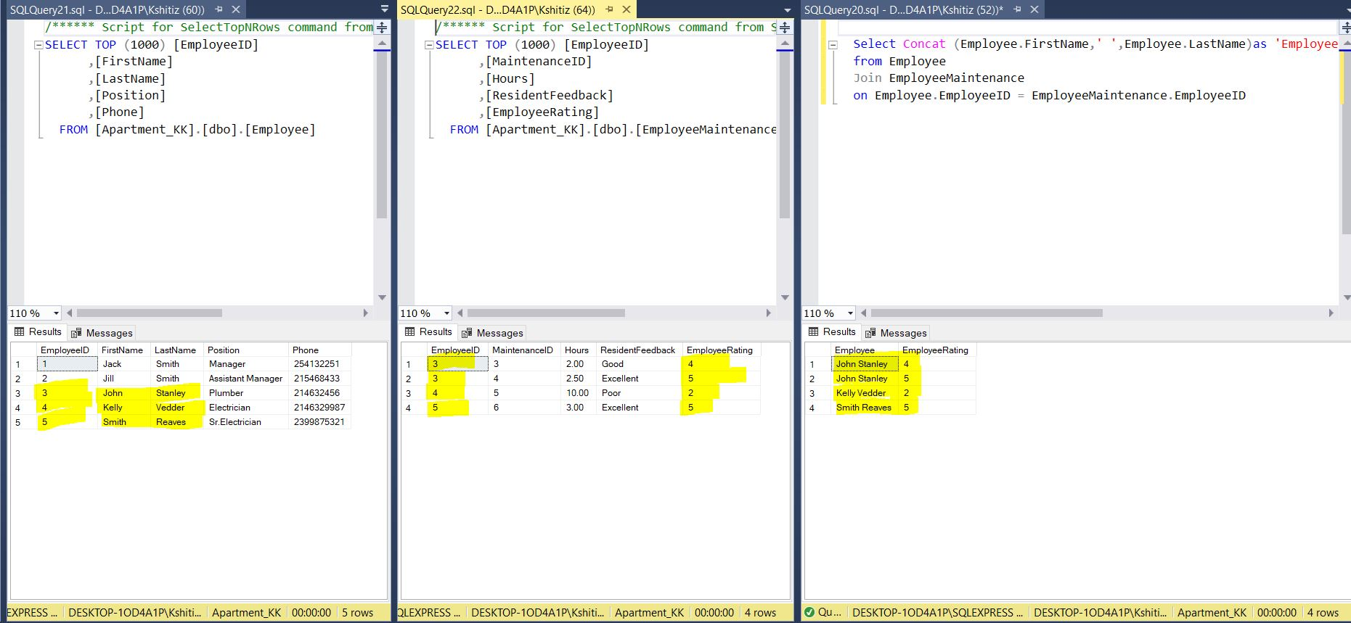
Employee Rating Given by the Resident with respective Employee Name

Slide 2
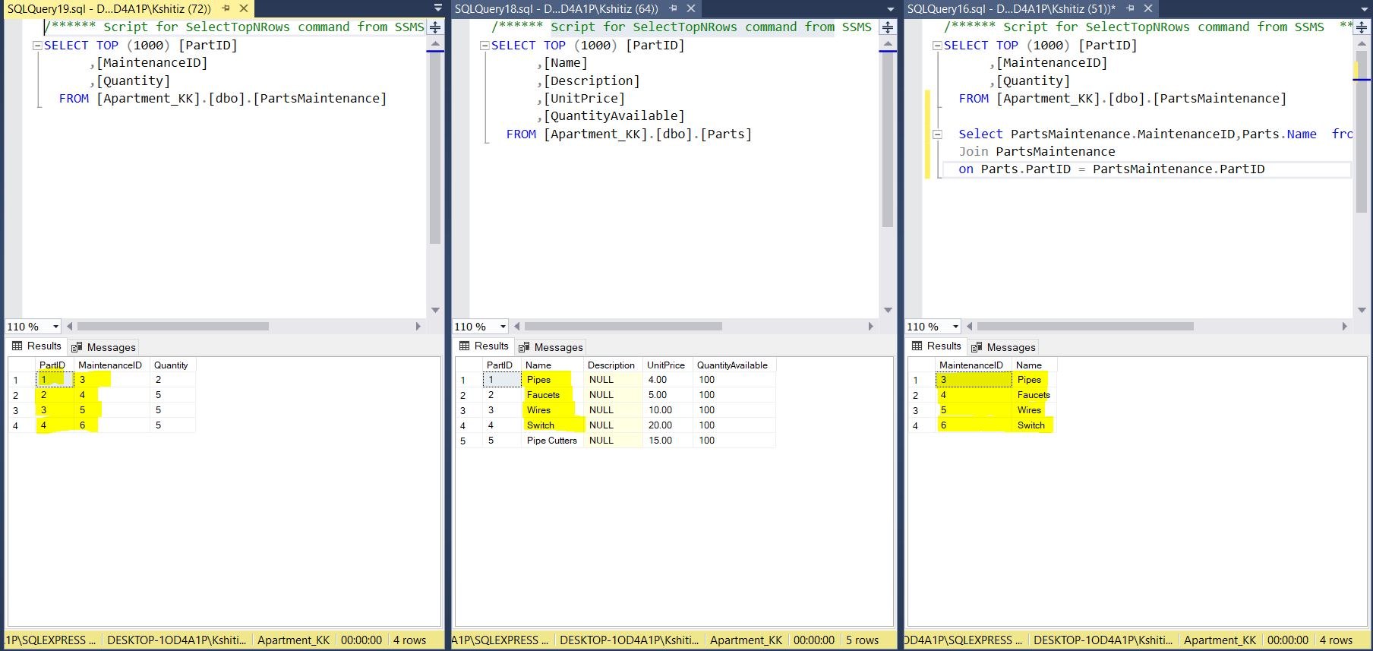
Parts Used in a Maintenance

Slide 3
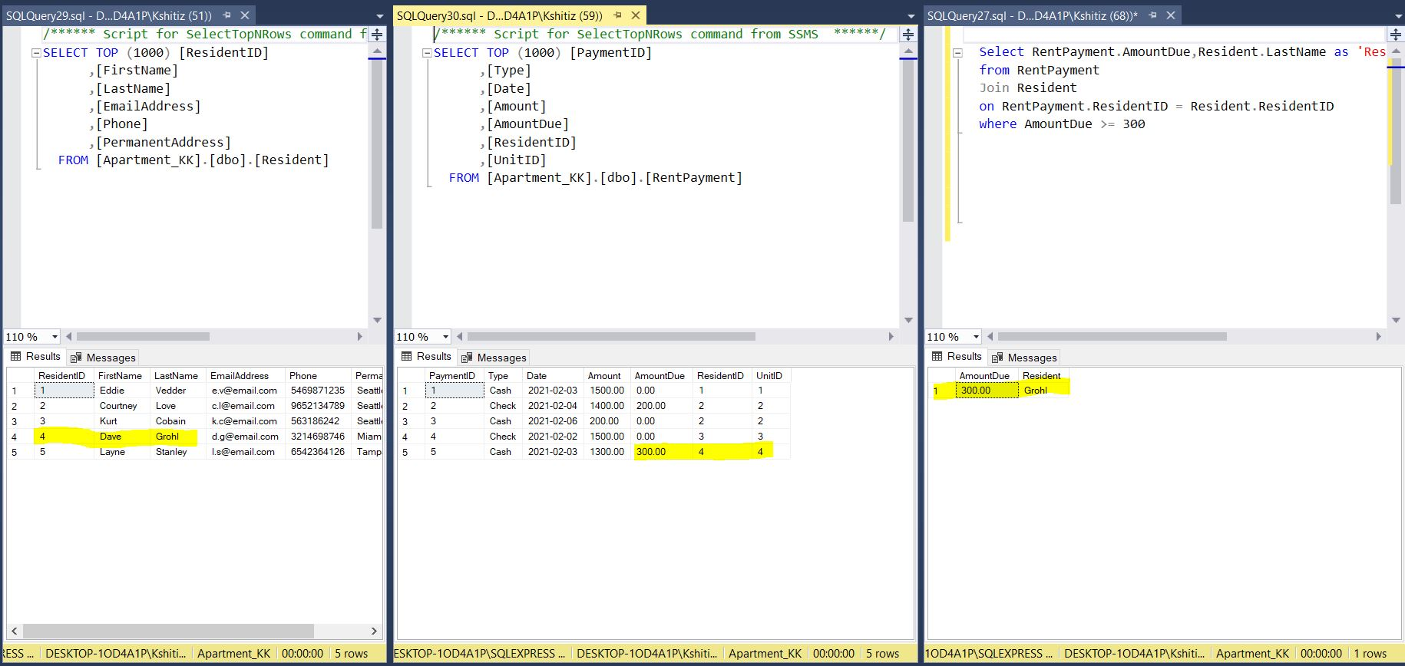
Resident who has amount due greater than or equal to 300

Slide 4
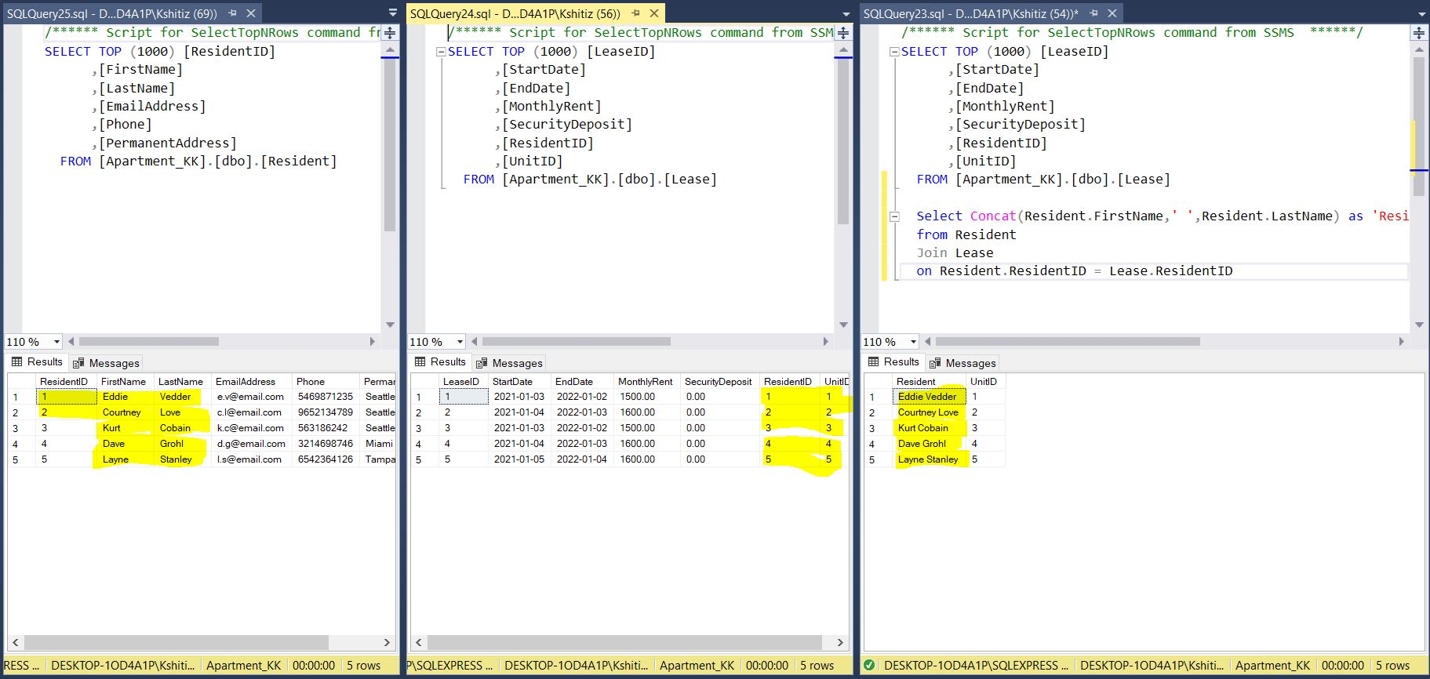
Residents with their respective Unit

